Slide 1
Video Content Analysis (YOLO) Prajjwal Chittori 2K18/CO/249

Slide 2

Welcome!
This is a Machine Learning Project on (video analysis) YOLO.
The testing environment is Google Colab and the network used is Darknet.

Slide 3
Introduction
Convolution Neural Networks comes under deep neural networks that are used to analyse visual information and imagery. They are based on shared-weights architecture and translation invariance charactertics. Yolo(you only look once) is convolution neural network model used for object identification in images and videos. The approach for Improving the algorithm includes testing of features on large datasets, with features such as batch-normalization and residual-connection.

Slide 4
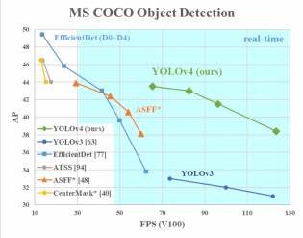
Weighted Residual Connections (WRC), Cross Stage Partial connections (CSP), Cross mini Batch Normalization (CmBN), Self-adversarial-training (SAT) and Mish-activation will be used in the model.

Slide 5
Advantages over preexisting models
The model is able to trainable on modern conventional personal computing GPUs such as Nvidia 2080 Ti and other AMD equivalents.
Working on Bag of specials method for object detection.
Implementation of CBN,PAN and SAM that are easier to execute on slower systems.
Situations where fast object identification Is needed such as car collision warning systems the models are inaccurate because of lack of efficient algorithms and lack of computational power for such minute time instances. Modern accurate object identification models work not in real time and require large computational and GPU processing.

Slide 6
Literature review
The research paper that were referenced and studied to implement the YOLO algorithm are-
• YOLOv4: Optimal Speed and Accuracy of Object Detection(Alexey Bochkovskiy, Chien-Yao Wang, Hong-Yuan Mark)
• You Only Look Once: Unified, Real-Time Object Detection(Joseph Redmon, Santosh Divvala, Ross Girshick, Ali Farhadi)
• Object Detection with Deep Learning: A Review(Zhong-Qiu Zhao, Shou-tao Xu, Xindong Wu)

Slide 7
Literature review
It has been proposed to use Convolutional neural network system. These papers have worked on this basic CNN with many modifications and feature implementations to make this network work faster.
The system works on unifying several components of object detection into a single convolutional neural network. The network implements features from every single frame of the video or several images to construct each bounding box by prediction. This will also be implemented by predicting bounding boxes across all classes for a video. This results in the network reasoning globally about the full image and all the objects in the image.

Slide 8
Theory
“You Only Look Once” implements a model that uses convolutional neural networks for video analysis in the field of object detection. It works on the principle of fast object detection but sometimes there are instances of not that accurate results provided by the model because of the speed constraint, but generally it is accurate enough for real time fast object detection systems.
YOLO comprises of:
• Backbone: CSPDarknet
• Neck: SPP , PAN
• Head: YOLOv3
The method uses-
• Bag of Freebies method (BoF) for backbone and detector
• Bag of Specials method(BoS) for backbone and detector

Slide 9
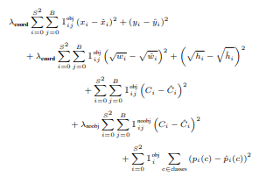
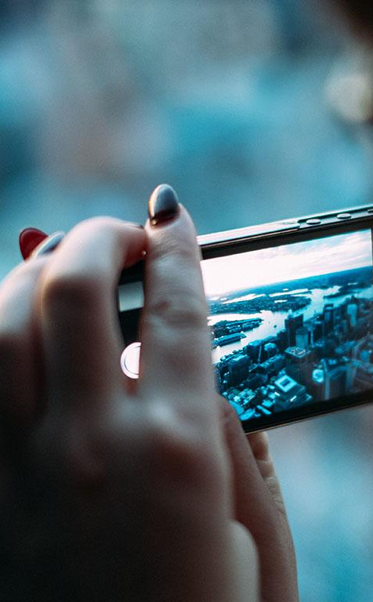
Loss Function-

Slide 10

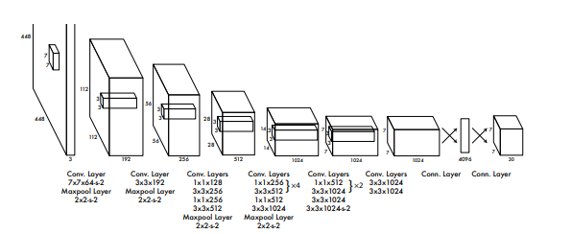
Model Representation

Slide 11
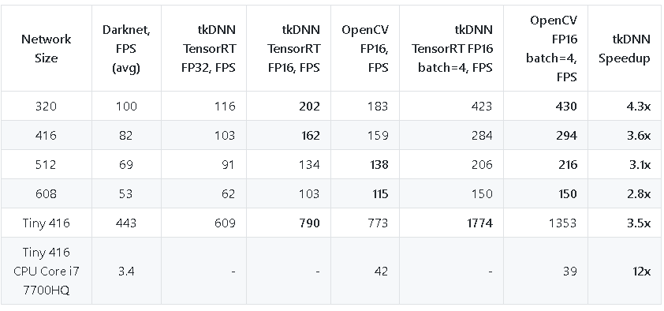
Comparison with other models

Slide 12
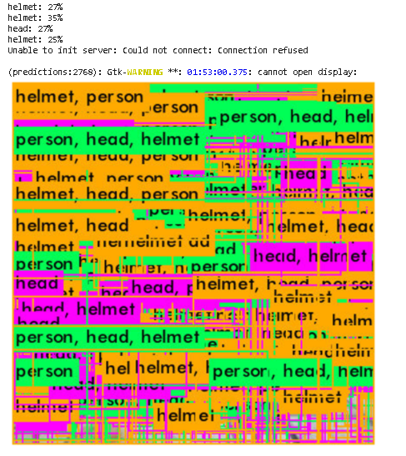
Result after 200 iterations

Slide 13
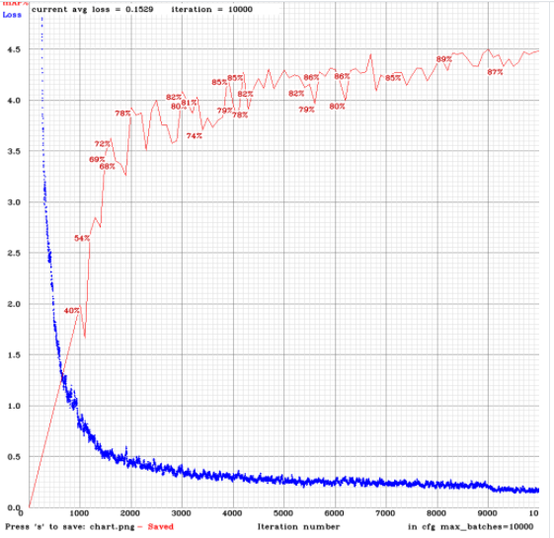
mAP and Loss Plot

Slide 14
Innovations in v4
Changes to following methods are made-
Bunch Normalization
Bounding Box Predictions
Feature Pyramid Networks (FPN)
Relation between Resolution and performance
Class Predictions
Multi-Scale Training

Slide 15
Conclusion
Fast YOLO is the quickest general-purpose object detector in the literature and YOLO pushes the cutting edge in real-time object detection. YOLO additionally generalizes well to new areas making it ideal for applications that rely on quick, robust object detection.
We offer a cutting-edge detector which is faster (FPS) and more accurate (MS COCO AP50...95 and AP50) than all accessible alternative detectors. The detector described can be trained and utilized on an ordinary GPU with 8-16 GB-VRAM this makes its broad utilize conceivable

Slide 16
THANKS!
Any questions?
You can find me at:
prajjwalchittori1@gmail.com

